Slide 1




T&J Jewelry
Max Chervinsky, Andrew Clark, Andrew Garmon, Jacob Johnson

Slide 2

About T&J
What is T&J?
Where was the org?
What was our goal?

Slide 3
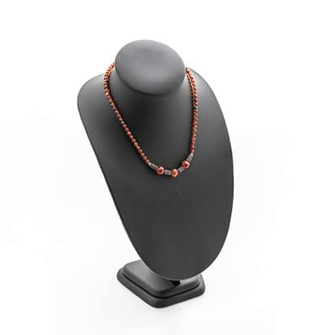
Conversion of Pages
Home page
Cart page
Account form
Andrew G

Slide 4
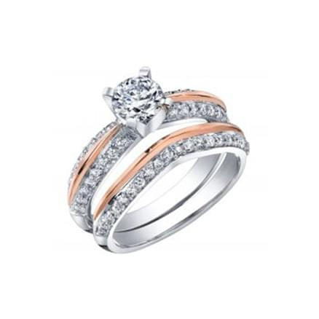
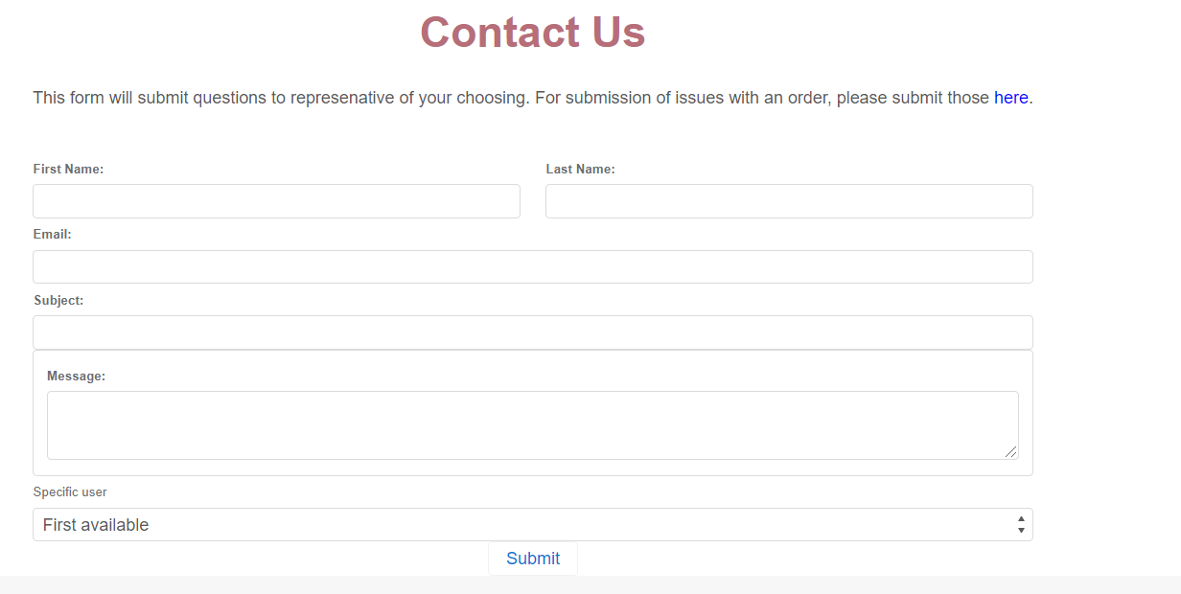
Contact Us
Customer facing
Select individual representative
Automated email
Code coverage

Slide 5
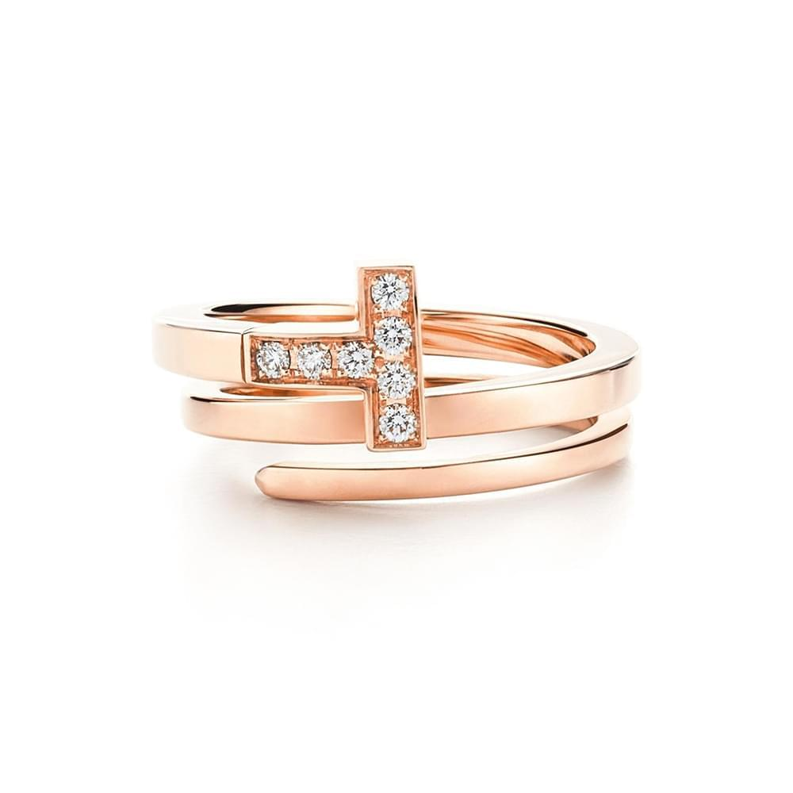
About Us

Slide 6
Product Search
Displays a table of store products available
Takes in Name of product, Jewelry Type, and Jewelry Style
Since Jewelry Style Picklist is dependent on Jewelry Type, the input field doesn't render until a Jewelry Type is picked
Filters data returned based on the user's input
Testing percentage: 73%

Slide 7
Andrew G

Slide 8
Sales/Service Cloud
Dashboard of product information
Case submission
Separate from Contact Us

Slide 9
Demonstration

Slide 10
Future Work
Dynamic VIPs
Contact form attachments
More aura components

Slide 11
Questions?

